Slide 1
Account Summary
dbt Pipeline Assignment

Slide 2
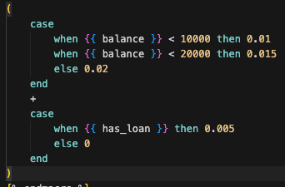
Description
Build a Dagster and dbt pipeline to process bank account interest.

Slide 3
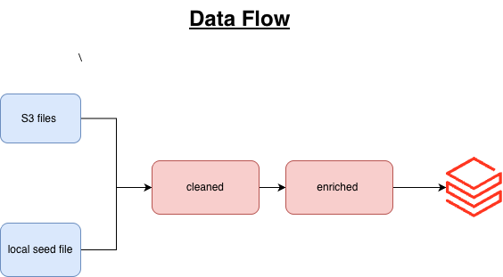
Data Flow

Slide 4
Build and Run
docker build --no-cache -t lending-dbt .
docker run --rm -p 3000:3000 --env-file .env lending-dbt

Slide 5
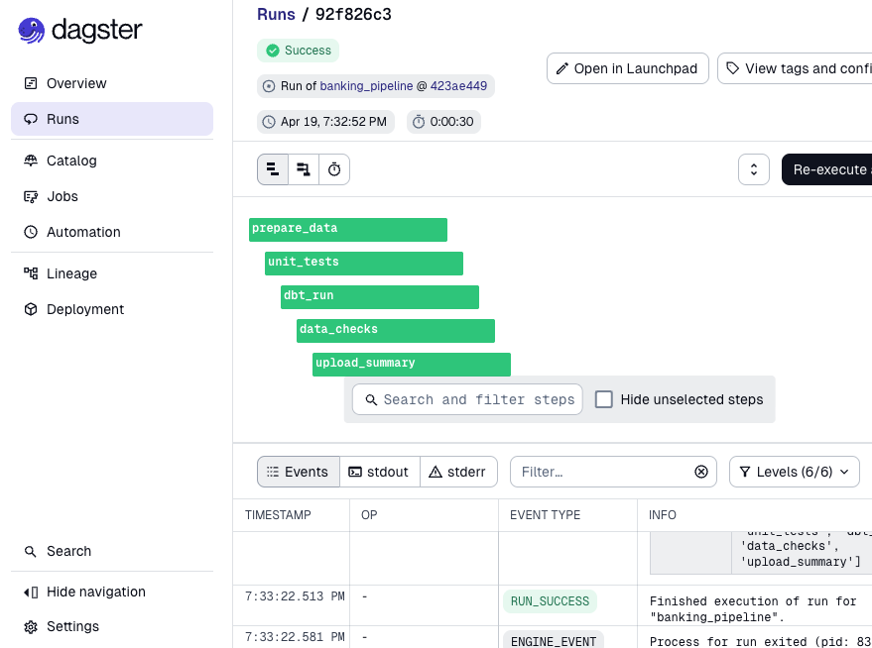
Dagster Workflow

Slide 6
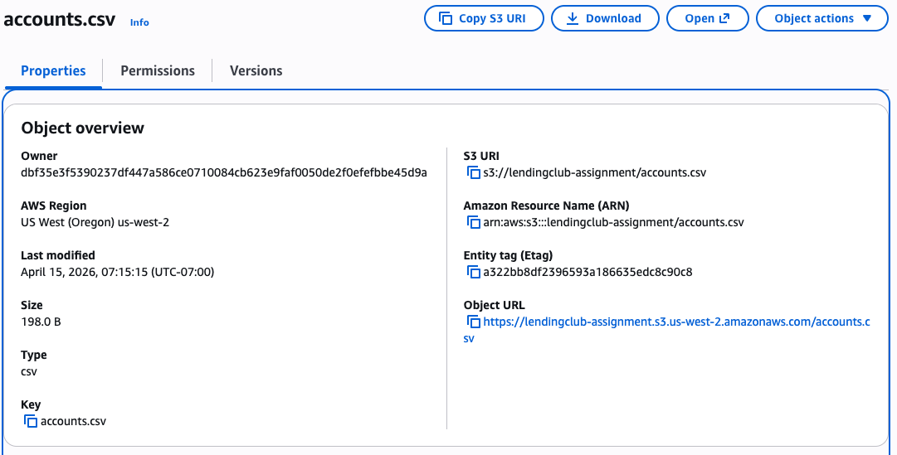
Input from AWS

Slide 7
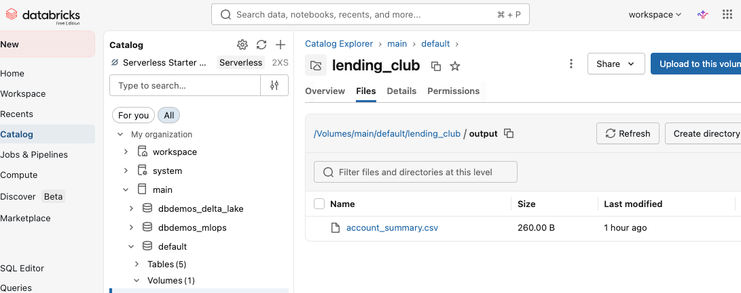
Output in Databricks

